Slide 1
PREDICTION OF COLOMBIAN STUDENTS’ ACADEMIC SUCCESS USING DECISION TREES
ALGORITHMS
Juliana Restrepo Tobar
David Vergara Patiño
Andrea Carvajal Maldonado
Medellín, June 2020

Slide 2
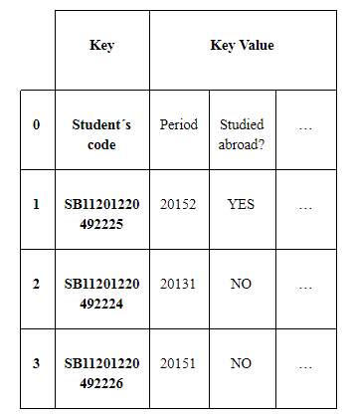
Designed Data Structure
1. Data Frame
Figure 1: Data Frame of students and their information. The student’s code is the key and all information such as ID, age, genre is they key value.

Slide 3
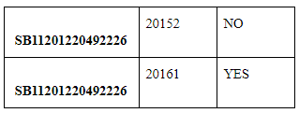
Operations
Figure 2: Information access operation
Figure 3: Concatenating two data frames

Slide 4
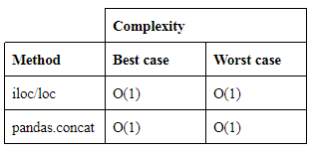
Time and Complexity Analysis
Table 1: Complexity of some operations in Data Frame
Table 2: Results analysis

Slide 5
Design Criteria
Since the format of the input data is a matrix, it is very convenient to store it in a table-like structure.
Data frames allow storing different data types.
One of the most used data structures when working with big data and AI.
Efficient and easy way of organizing and managing a large volume of information.

Slide 6
Time and Memory Consumption
Graph 1:Time taken to create the data frame
Graph 2: Memory consumption of the data

Slide 7
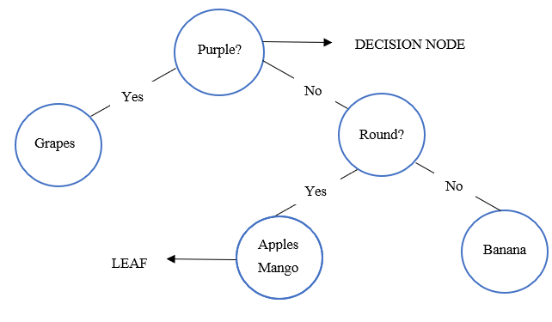
Designed Data Structure
2. Binary Decision Tree
Figure 3: Binary Decision Tree.

Slide 8
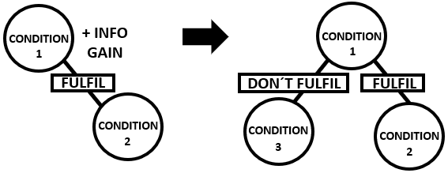
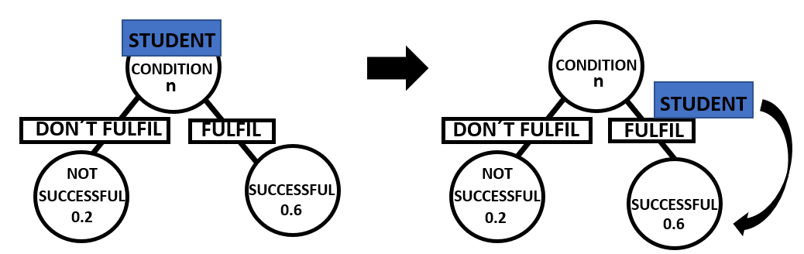
Data Structure Operations
Figure 3: Creation of a binary decision tree
Figure 4: Classifying a student

Slide 9
Time and Complexity Analysis
Table 3: Complexity of the decision tree’s operations.
Table 4: Results analysis.

Slide 10
Design Criteria
CART is the latest, most used decision tree algorithms with C5.
Consumes less memory and has a lower probability of misclassification than C5.0.

Slide 11
Time and Memory Consumption
Graph 3:Time taken to create the decision tree
Graph 4: Memory consumption of the data

Slide 12
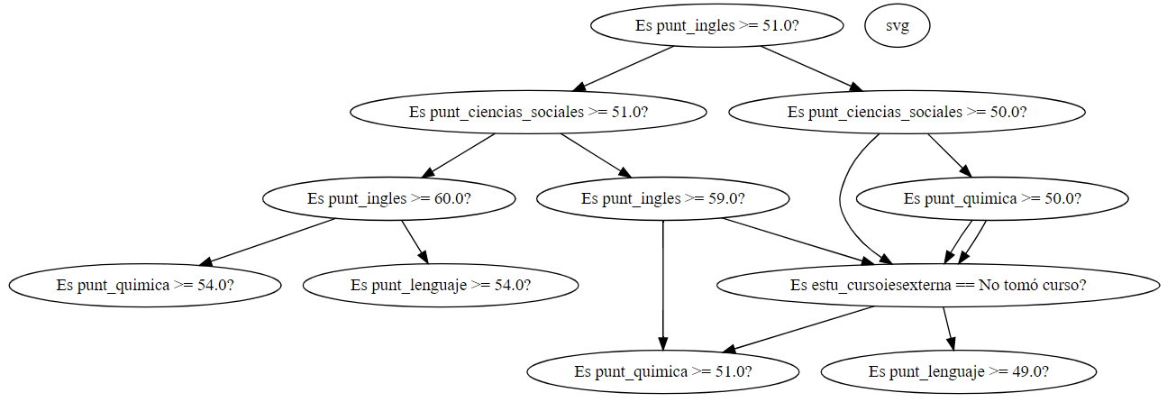
Implementation

Slide 13
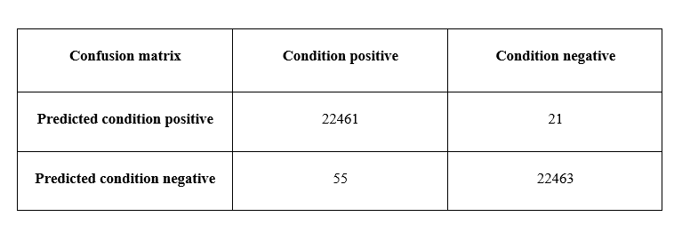
Implementation
GitHub link: https://github.com/jrestrepot/ST0245-032/blob/master/proyecto/codigo/proyecto_final_datos1.py
Accuracy percentage: 99.8%
Table 5 :Time taken to create the decision tree

Slide 14
Applications
Universities can use it to easily recognize excellent students and contact them for admission or scholarship processes.
Also can be used to predict which active students are more likely to have a low score on their exam so they can provide them with special attention.
Can be applied by the government to reinforce aspects in the educational system.

